Slide 1
Why Have College Completion Rates Declined?
An Analysis of Changing Student Preparation and Collegiate Resources
John Bound, Michael F. Lovenheim, and Sarah Turner
American Economic Journal: Applied Economics, 2010, 2(3), 129–157
ELP 390G · Economics of Education
Week 3 · Opportunity Cost and College Enrollment

Slide 2
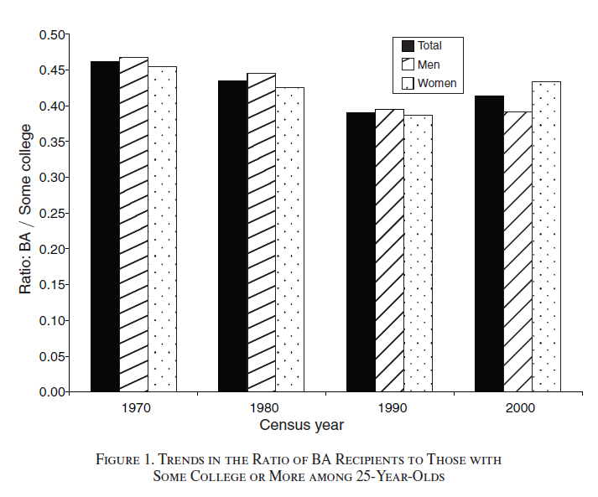
What does this figure show about graduation rates?
2
Figure 1: ratio of BA recipients to those with some college or more, among 25-year-olds

Slide 3
This paper is a “fact paper”
3
It establishes a fact, then tries to explain it
Between the 1972 and 1992 high school cohorts, college completion fell from 50.5% to 45.9%
  Completion means a BA within eight years of finishing high school
  Two national longitudinal surveys: NLS72 and NELS:88
A 4.6 percentage point fall — over exactly the period when college enrollment was expanding fastest
What are some potential explanations?

Slide 4
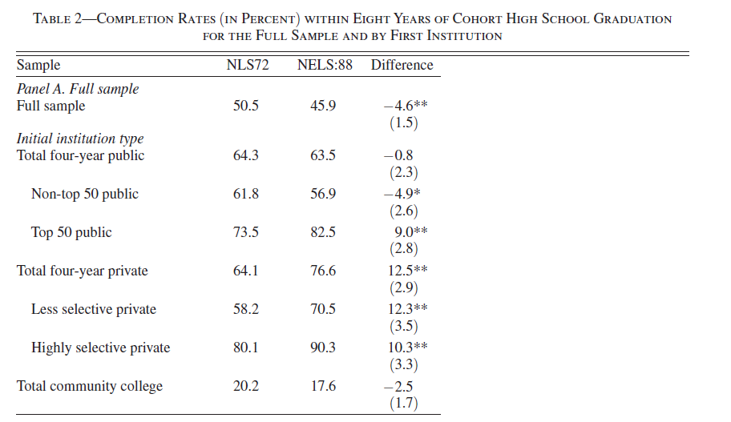
Did completion fall everywhere?
4
No. Completion rose at more selective colleges and fell at less selective ones
  Top-50 public: 73.5% → 82.5% (+9.0)
  Private colleges: +10 to +12 at both selectivity levels
  Non-top-50 public: 61.8% → 56.9% (−4.9)
  Community college: 20.2% → 17.6% (−2.5)
So the decline is not a story about colleges getting worse at graduating students
Table 2: completion within eight years, by first institution

Slide 5
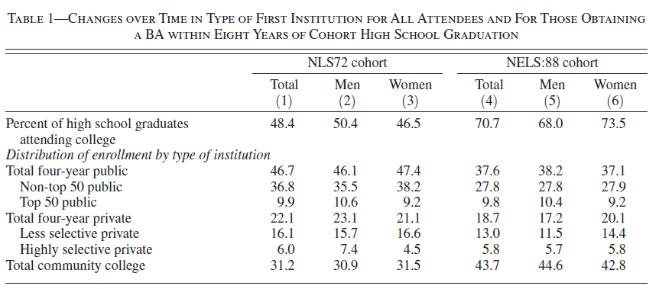
Where did students go instead?
5
College-going rose steeply: 48.4% → 70.7% of high school graduates enrolled somewhere
And the mix shifted toward community colleges
  Four-year public: 46.7% → 37.6% · Community college: 31.2% → 43.7%
Enrollment grew fastest exactly where completion is lowest
Table 1: type of first institution, all attendees and BA recipients

Slide 6
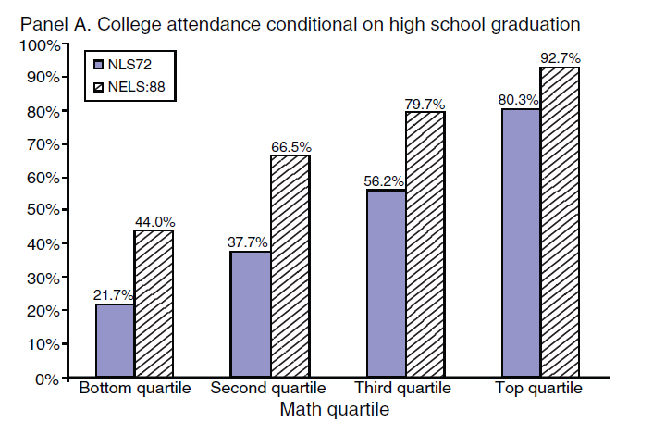
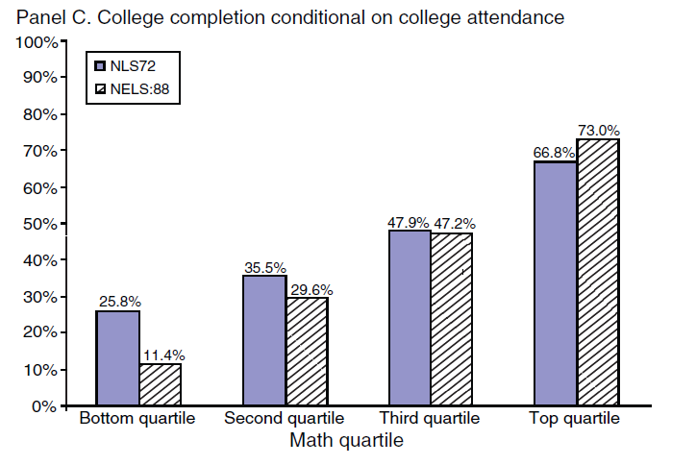
How did college enrollees change?
6
Attendance rose most among the least-prepared students
  Bottom math quartile: 21.7% → 44.0% · Top quartile: 80.3% → 92.7%
And completion, conditional on attending, fell most for those same students
  Bottom math quartile: 25.8% → 11.4% · Top quartile: 66.8% → 73.0%
Figure 2, Panels A and C: college attendance and completion by math test quartile

Slide 7
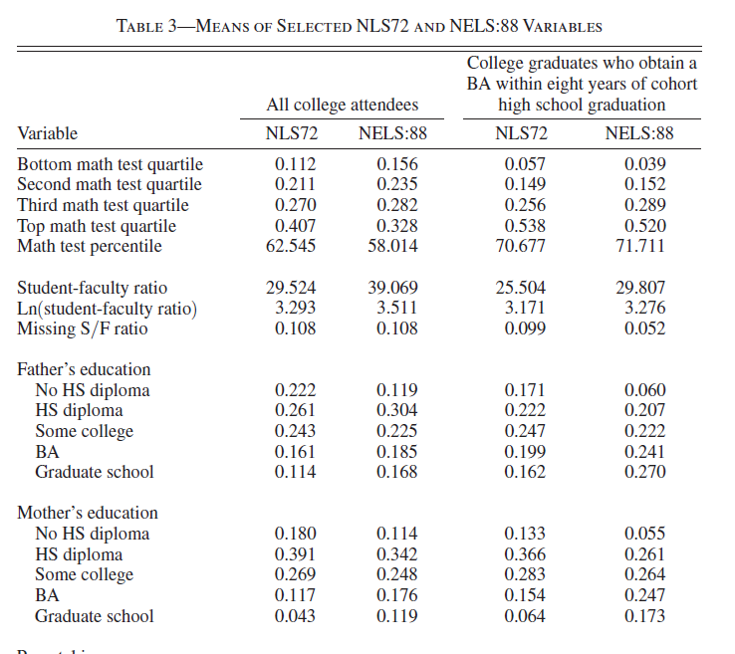
Were students less prepared?
7
Preparation slipped a little
  Mean math test percentile: 62.5 → 58.0
  Bottom math quartile: 11.2% → 15.6% of enrollees
But family background improved a lot
  Fathers with no HS diploma: 22.2% → 11.9%
  Mothers with a BA or more: 16.0% → 29.5%
These push in opposite directions, so together they explain almost none of the decline
Table 3: means of selected variables
More characteristics

Slide 8
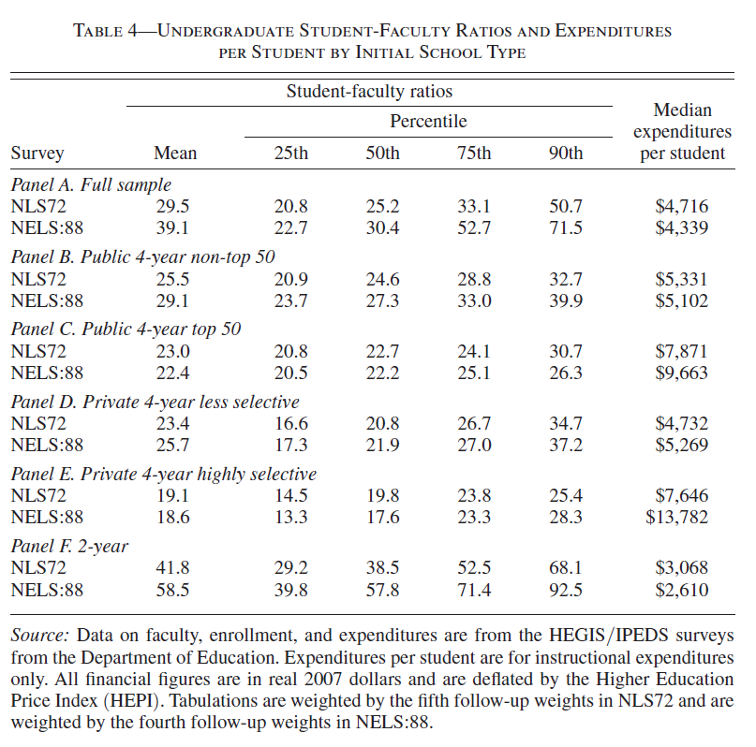
What happened to resources?
8
Students per faculty member: 29.5 → 39.1
Median instructional spending per student fell: $4,716 → $4,339 (2007 dollars)
But resources diverged sharply across sectors
  Highly selective private: $7,646 → $13,782
  Top-50 public: $7,871 → $9,663
  Community college: $3,068 → $2,610
Many more students, not much more money — and the new money went where the new students did not
Table 4: student–faculty ratios and expenditures per student

Slide 9
Are test scores comparable over time?
9
They argue yes — NAEP scores are essentially flat across these cohorts
This assumption does a lot of work
  The whole comparison requires that the same math percentile means the same preparation in 1972 and in 1992
What if high school students really were better prepared than these tests capture?
  Then the paper understates how much student characteristics improved — and the decline it has to explain gets larger, not smaller

Slide 10
How do they figure out what caused the decline?
10
A decomposition, not an experiment
  Predict completion from student and school characteristics, then ask how much of the 4.6-point fall those changes alone would predict
The framework splits the candidates in two
  Supply side (schools): where students enroll, resources per student
  Demand side (students): preparation, family income, parental education
Is this causal?
  No. It is an accounting exercise — it tells you which changes line up with the decline, not which ones caused it

Slide 11
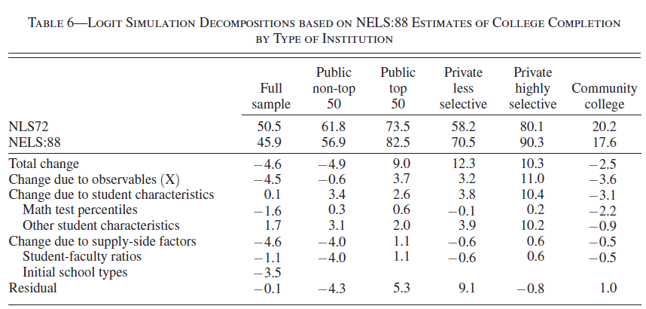
What explains the decline?
11
Almost all of the 4.6-point decline sits on the supply side
  Where students enrolled: −3.5 points · Student–faculty ratios: −1.1 points
  Student characteristics: +0.1 points — essentially nothing
The decline is about institutions and resources, not about who went to college
Table 6: logit simulation decompositions of college completion, by type of institution

Slide 12
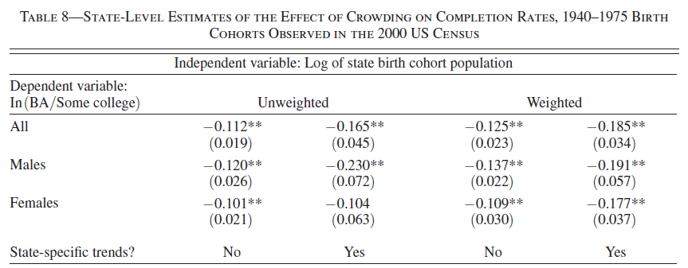
Is it really about resources?
12
A second test, closer to a causal design: cohort crowding
  States with unusually large birth cohorts later send unusually large cohorts to college — more students competing for the same seats and dollars
Completion is lower for those crowded cohorts
  A 10% larger birth cohort lowers the BA-to-some-college ratio by roughly 1 to 2%
  Holds for men and women, with and without state-specific trends
Table 8: state-level estimates of the effect of crowding, 1940–1975 birth cohorts

Slide 13
Time to Degree
13
Bound, Lovenheim & Turner (2012), Education Finance and Policy

Slide 14
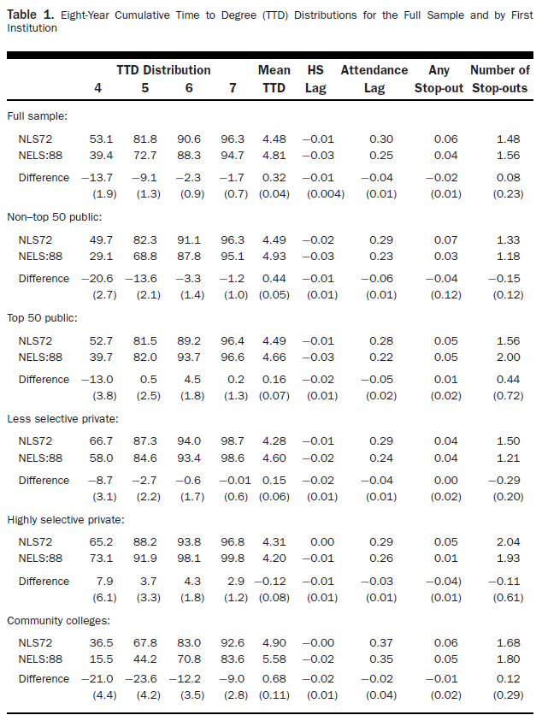
What happened to time to degree?
14
Students did not just complete less — those who finished took longer
  Share finishing in four years: 53.1% → 39.4%
  Mean time to degree: 4.48 → 4.81 years
The increase is concentrated in the same places as the completion decline
  Non-top-50 public: 4.49 → 4.93 years
  Community college entrants: 4.90 → 5.58 years
  Highly selective private: no increase (4.31 → 4.20)
The same decomposition explains much less of this change than it did for completion
Table 1: eight-year cumulative time-to-degree distributions

Slide 15
What to take away
15
Completion fell 4.6 points between the 1972 and 1992 cohorts — but only in the aggregate
Completion rose at selective colleges and fell at open-access ones. The average fell because enrollment moved toward the open-access sector
The decline tracks where students enrolled and how many students each faculty member faced — not who enrolled
The cohort-crowding evidence independently supports the resources story
Time to degree rose in the same sectors, for the same reasons

Slide 16
What would you tell a Texas policymaker?
16
Enrollment grew and appropriations per student did not follow. Something had to give — what did?
Whose completion rate would you target: the state average, or completion at the open-access institutions where most new students went?
The paper measures instructional spending per student. If you raised it, what would you give up?
How much weight can a decomposition bear when you use it to argue for a policy?

Slide 17
Extra Slides
17

Slide 18
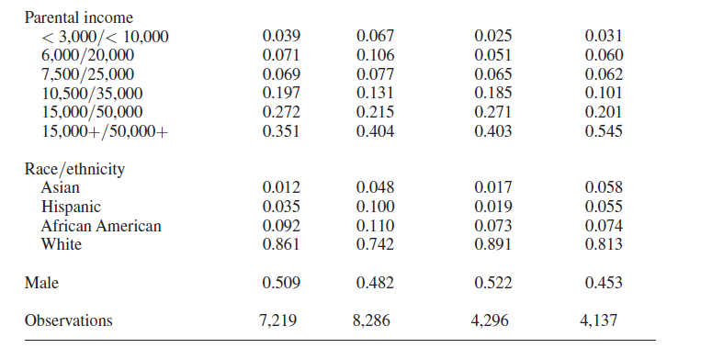
Student characteristics: NLS72 vs. NELS:88
18
Table 3, both panels: means of selected NLS72 and NELS:88 variables

