Slide 1
Why Have College Completion Rates Increased?
Jeffrey T. Denning, Eric R. Eide, Kevin J. Mumford,
Richard W. Patterson, and Merrill Warnick
American Economic Journal: Applied Economics, 2022, 14(3), 1–29
ELP 390G · Economics of Education
Week 3 · Opportunity Cost and College Enrollment

Slide 2
Where we left off
2
Bound, Lovenheim & Turner (2010) documented that college completion fell from the 1970s to the 1990s
Their explanation was mostly supply side: where students enrolled, and resources per student
That paper was influential for two reasons
  It established the fact
  It put institutions at the center of the story (Cohodes & Goodman 2014; Goodman, Hurwitz & Smith 2017; Zimmerman 2014)
This paper asks what happened next

Slide 3
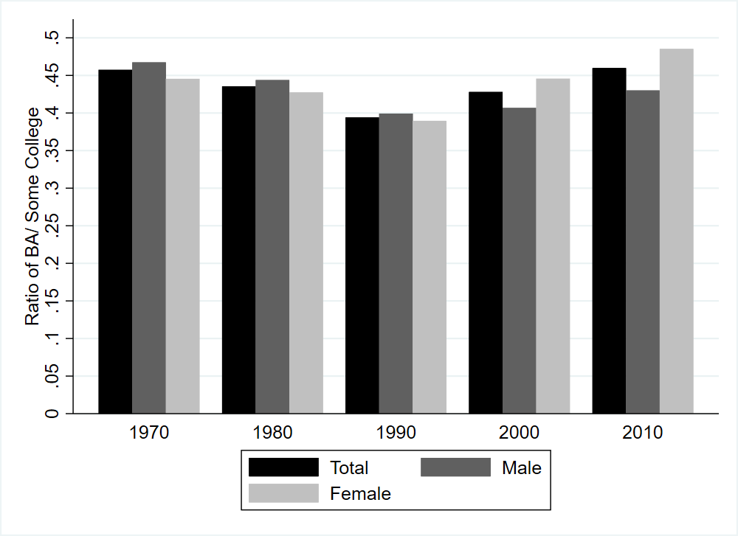
What happened after 1990?
2
The same Census series BLT used, extended two more decades
BA holders relative to those with some college
  1970: .46 · 1990: .39 · 2010: .46
The decline BLT documented reversed completely
Decennial Census: ratio of BA to some college, 25-year-olds

Slide 4
This paper
2
What has happened to college completion since 1990?
  Completion rates have increased
Why have completion rates increased?
  The explanations in BLT do not account for the change — they point the wrong way
So the paper proposes a new explanation
  Falling standards for degree receipt — grade inflation

Slide 5
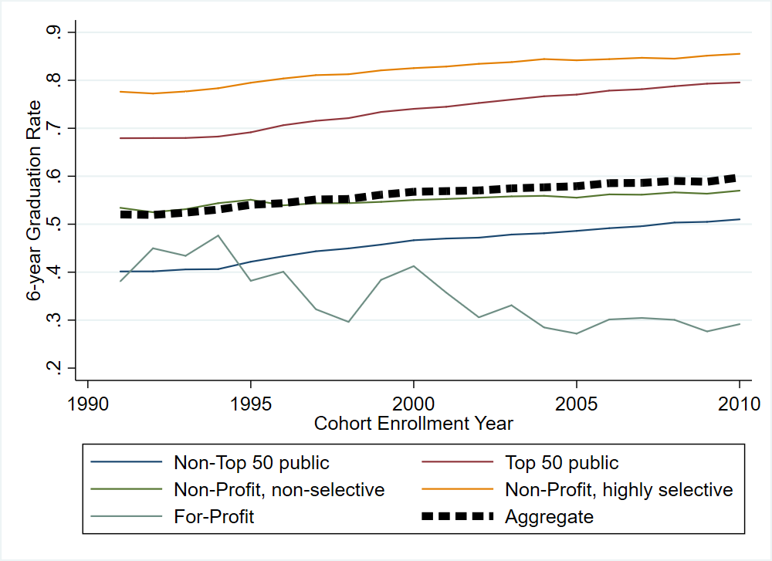
Did completion rise everywhere?
2
Six-year graduation rates rose from about 52% to 60% between the 1991 and 2010 entering cohorts
Every sector rose except for-profits
  Top-50 public: .68 → .80
  Non-top-50 public: .40 → .51
  Highly selective non-profit: .78 → .86
  For-profit: .38 → .29
IPEDS: six-year graduation rate by sector, Title IV colleges

Slide 6
How do we know?
2
Three imperfect sources that tell the same story
  Decennial Census: BA relative to some college
  IPEDS: first-time, full-time entrants at Title IV colleges
  NELS:88 and ELS:2002: the 1992 and 2004 high school cohorts, followed individually
In the micro data, completion rose from 48.7% to 52.5%
  Up in every sector except less selective privates and for-profits
Sample | 1988 | 2002 | Difference
Full Sample | 48.7 | 52.5 | 3.77
 |  |  | (1.71)
Initial Institution Type
Total Four-year Public | 63.3 | 67.7 | 4.49
 |  |  | (2.38)
Non-top 50 Public | 56.1 | 61.0 | 4.89
 |  |  | (2.59)
Top 50 Public | 82.1 | 90.7 | 8.57
 |  |  | (2.57)
Total Four-year Private | 78.4 | 77.2 | -1.14
 |  |  | (2.30)
Less Selective Private | 72.3 | 71.2 | -1.05
 |  |  | (2.96)
Highly Selective Private | 90.5 | 92.2 | 1.66
 |  |  | (2.76)
Total Community College | 19.6 | 24.3 | 4.77
 |  |  | (1.71)
For-Profit College | 25.2 | 24.7 | -0.42
 |  |  | (8.92)
All Non-Profit Colleges | 48.8 | 53.0 | 4.18
 |  |  | (1.72)
All Four-Year Colleges | 68.3 | 70.6 | 2.31
 |  |  | (1.85)
NELS:88 vs. ELS:2002 completion rates, by initial institution type
Sample means

Slide 7
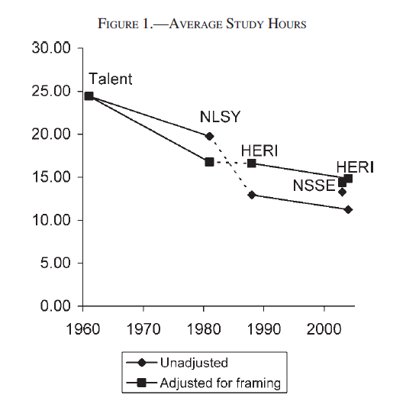
What should have pushed completion down?
2
Enrollment expanded: 69.3% → 78.3% of the cohort
Preparation is flat — NAEP math and reading unchanged
Employment during college is up (Scott-Clayton 2012)
Price is up; state support per student has stagnated (College Board 2017)
Study time fell from about 24 hours a week to 14 (Babcock & Marks 2011)
The mix of institutions is largely unchanged
Every one of these predicts lower completion — so the explanation is something else
Babcock & Marks (2011): average study hours

Slide 8
Can BLT’s explanations account for the increase?
2
The same decomposition and variables, applied to NELS:88 and ELS:2002
Completion rose 3.8 points, but students and schools together predict a fall of 1.9 points — leaving 5.7 points unexplained
 |  |  | Full Sample | Public non-top 50 | Public top 50 | Private Less Selective | Private Highly Selective | Community College | For-Profit Schools
NELS:88 |  |  | 48.73 | 56.12 | 82.15 | 72.26 | 90.50 | 19.56 | 25.15
ELS:2002 |  |  | 52.50 | 61.01 | 90.71 | 71.21 | 92.16 | 24.33 | 24.73
Total Change |  |  | 3.77 | 4.89 | 8.57 | -1.05 | 1.66 | 4.77 | -0.42
Change due to Observables |  |  | -1.92 | -4.45 | -0.42 | -0.61 | 3.60 | -0.81 | 9.43
Change due to Student Characteristics |  |  | -1.64 | -2.64 | -0.43 | -0.63 | 2.68 | -0.84 | 9.43
 | Math Test Percentile |  | -1.26 | -2.04 | 0.15 | -0.78 | 0.26 | -0.96 | 0.26
 | Other Student Characteristics |  | -0.39 | -0.60 | -0.58 | 0.15 | 2.42 | 0.12 | 9.17
Change due to Supply-Side Factors |  |  | -0.28 | -1.82 | 0.00 | 0.02 | 0.92 | 0.03 | 0.00
 |  | Student/Faculty Ratios | -0.28 | -1.82 | 0.00 | 0.02 | 0.92 | 0.03 | 0.00
 |  | Initial School Types | 0.00
Residual |  |  | 5.69 | 9.35 | 8.99 | -0.44 | -1.94 | 5.58 | -9.86
BLT decomposition applied to NELS:88 and ELS:2002
How it works

Slide 9
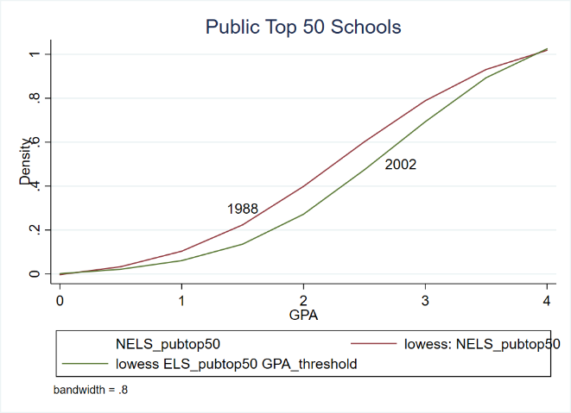
What changed that we have not looked at?
2
First-year GPA rose from 2.44 to 2.65
Grades are up throughout the distribution
11% of students moved from below a 2.0 to above a 2.0 — the margin where probation and dismissal bite
The paper's proposal: grade inflation — higher grades without higher performance
Cumulative distribution of first-year GPA, public top-50 schools

Slide 10
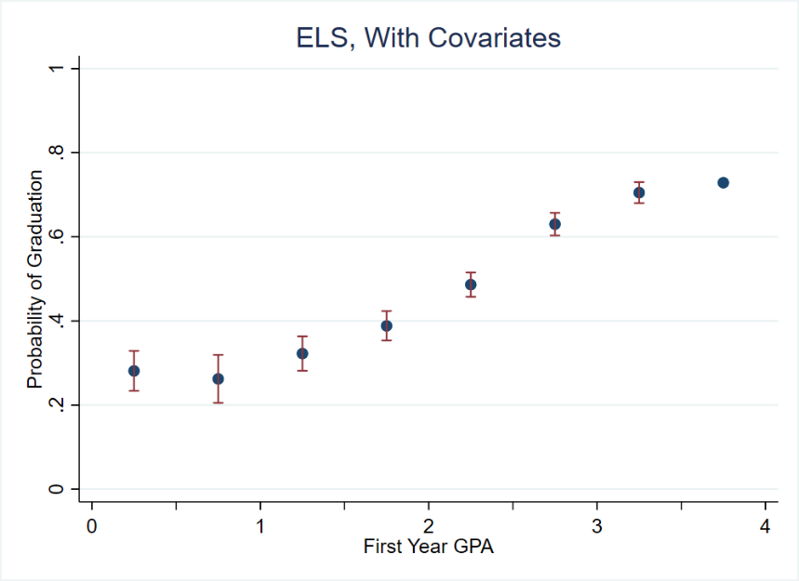
Why would grades matter for completion?
2
Grades strongly predict graduation
The relationship is steepest between a 2.0 and a 3.0 GPA
That is exactly where grades moved
Two plausible mechanisms
  Academic probation and dismissal rules key off GPA thresholds
  Grades tell a student how well they are doing, which shapes whether they persist
Probability of graduation by first-year GPA, ELS:2002

Slide 11
Did students get better, or did grading get easier?
2
Three progressively tighter tests, all with the same answer
NELS and ELS. Student characteristics, major, and course taken cannot explain it — the 2002 gap stays near 0.3 grade points
Nine large public universities. Across 411,951 students, GPAs still rise after holding constant SAT scores, home ZIP code, university, major, and first-semester courses
One public liberal arts college. Same course, same exam, same score — higher grade
So: do two students who understand the material equally well get the same grade over time? No.
NELS / ELS
MIDFIELD

Slide 12
Same exam, same score: did the grade change?
2
Some courses at one public liberal arts college gave the same final exam year after year, so grades can be compared at identical measured performance
Grades still rise about 0.02 points a year holding the course and the final exam score fixed — and about 0.05 to 0.06 a year in science courses
 | All Freshman Courses |  |  |  |  | Required | Science
 | (1) | (2) | (3) | (4) |  | (5) | (6) | (7) | (8)
Year of Entry | 0.025 | 0.023 | 0.024 | 0.021 |  | 0.021 | 0.060 | 0.053 | 0.060
 | (0.001) | (0.001) | (0.001) | (0.001) |  | (0.001) | (0.001) | (0.002) | (0.002)
Course Fixed Effects |  | X | X | X |  | X | X | X | X
Student Characteristics |  |  | X | X |  | X | X | X | X
Final Exam Scores |  |  |  | X |  | X | X | X
Exact Test Version Fixed Effect |  |  |  |  |  |  |  | X | X
Test-Specific Final Exam Scores |  |  |  |  |  |  |  |  | X
N | 139,190 | 139,190 | 139,190 | 139,190 |  | 127,184 | 26,697 | 20,773 | 20,773
Public liberal arts college: first-year course grades, by year of entry

Slide 13
So what do we conclude about grades?
2
GPAs are up
Student preparation cannot explain it
Student performance on identical exams cannot explain it
The paper concludes this is grade inflation
Is that the only reading of this evidence?

Slide 14
What explains the increase?
2
Add first-year GPA to the same decomposition
GPA alone accounts for 3.6 of the 3.8-point increase — about 95%. With GPA included, the unexplained residual falls from 5.7 to 1.3 points
 |  | Full Sample | Public non-top 50 | Public top 50 | Private Less selective | Private Highly Selective | Community College | For-Profit Schools
NELS:88 |  | 48.73 | 56.12 | 82.15 | 72.26 | 90.50 | 19.56 | 25.15
ELS:2002 |  | 52.50 | 61.01 | 90.71 | 71.21 | 92.16 | 24.33 | 24.73
Total Change |  | 3.77 | 4.89 | 8.57 | -1.05 | 1.66 | 4.77 | -0.42
Change due to Observables |  | 2.49 | 2.77 | 2.44 | 2.73 | 5.75 | 2.57 | 3.31
Change due to Student Characteristics |  | -0.92 | -1.65 | -0.85 | -0.01 | 2.27 | -0.41 | 7.13
 | Math Test Percentile | -0.75 | -1.12 | 0.08 | -0.30 | 0.06 | -0.65 | 0.32
 | Other Student Characteristics | -0.17 | -0.53 | -0.93 | 0.29 | 2.21 | 0.24 | 6.81
Change due to Supply-Side Factors |  | -0.16 | -1.68 | 0.00 | 0.00 | 0.69 | 0.09 | -0.13
 | Student/Faculty Ratios | -0.20 | -1.68 | 0.00 | 0.00 | 0.69 | 0.09 | -0.13
 | Initial School Types | 0.04
Change due to GPA |  | 3.57 | 6.09 | 3.29 | 2.74 | 2.78 | 2.89 | -3.69
Residual |  | 1.27 | 2.13 | 6.13 | -3.78 | -4.08 | 2.20 | -3.73
Decomposition including first-year GPA

Slide 15
Time to Degree
2
Denning, Eide, Mumford & Sabey (2022), Economics of Education Review

Slide 16
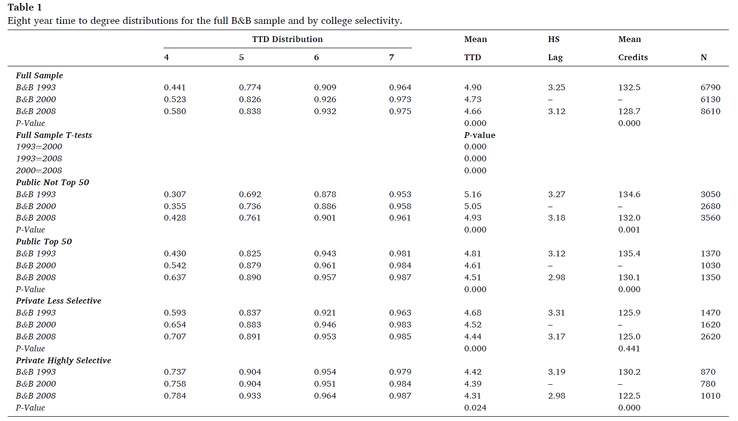
What happened to time to degree?
2
Time to degree fell while completion rose
  Share finishing in four years: 44.1% → 58.0%
  Mean time to degree: 4.90 → 4.66 years
  Mean credits earned: 132.5 → 128.7
The decline shows up in every sector
  Non-top-50 public: 5.16 → 4.93 years
  Top-50 public: 4.81 → 4.51 years
Eight-year time-to-degree distributions, B&B 1993, 2000, and 2008

Slide 17
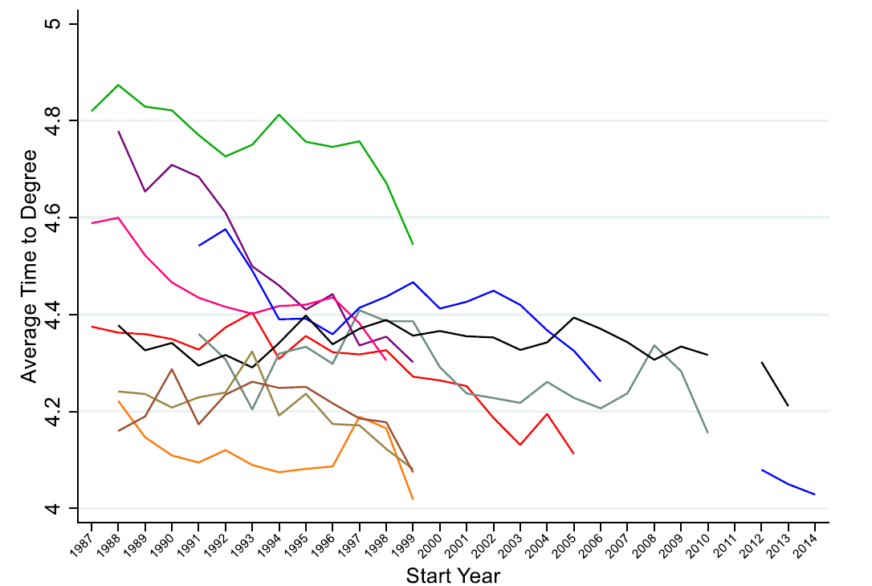
It fell almost everywhere
2
Average time to degree by institution, 1987–2014 entering cohorts
Institutions start at very different levels, but nearly every line trends down
Average time to degree by institution and start year

Slide 18
What to take away
2
College completion has risen since the early 1990s, in every sector except for-profits
The explanations that worked for the earlier decline — enrollment mix, resources, preparation — predict the opposite here
First-year GPAs rose, and the increase survives controls for preparation and for measured performance on identical exams
GPA accounts for roughly 95% of the rise in completion
Time to degree fell over the same period

Slide 19
How did this land outside economics?
2
The Atlantic, July 2019 — “Has College Gotten Easier?”
  theatlantic.com/education/archive/2019/07/has-college-gotten-easier/594550/
The Washington Post, September 2021 — “Why grade inflation is useful”
  washingtonpost.com/education/2021/09/21/why-grade-inflation-is-useful/
Both frame the finding as a story about standards. Is that what the paper shows?

Slide 20
What would you tell a Texas policymaker?
2
Completion rates are a headline accountability metric. If they rise because grading changed, what have we learned?
Is grade inflation bad? Who gains from it and who loses?
Two papers, the same method, opposite conclusions about what matters. What does that tell you about decompositions?
Put the two papers together: what would you now say drives college completion?

Slide 21
Extra Slides
2

Slide 22
How the decomposition works
2
Predict college graduation with a logit model using student and school characteristics
Take the estimated relationships from the later period (ELS:2002) and apply them to the characteristics of the earlier period (NELS:88)
Compare actual graduation in the later period with that prediction
  The gap is how much of the change all covariates together can account for
Repeat one covariate at a time to apportion the change
What is left over is the residual — the part no measured characteristic explains

Slide 23
Why are GPAs increasing? NELS and ELS
2
Student characteristics cannot explain the increase in GPA
 | First-year GPA
 | (1) | (2) | (3) | (4) | (5) | (6) | (7)
Coefficient on 2002 Indicator | 0.21 | 0.28 | 0.28 | 0.32 | 0.31 | 0.29 | 0.31
 | (0.029) | (0.025) | (0.025) | (0.025) | (0.026) | (0.028) | (0.026)
Student Characteristics |  | X | X | X | X |  | X
Major Graduation Rate |  |  | X
Major Fixed Effects |  |  |  | X
Course Indicators |  |  |  |  | X | X
Inconsistent Course Indicators |  |  |  |  |  | X
Total Math and Science Credits |  |  |  |  |  |  | X

Slide 24
Can preparation explain it? Nine large public universities
2
Registrar data from MIDFIELD: SAT fixed effects, ZIP code fixed effects, first-semester course fixed effects
  Clemson, Colorado, Colorado State, Florida, Florida State, Georgia Tech, NC State, Purdue, Virginia Tech
 | (1) | (2) | (3) | (4) | (5) | (6) | (7)
Year of Entry | 0.019 | 0.019 | 0.018 | 0.018 | 0.014 | 0.015 | 0.014
 | (0.000) | (0.000) | (0.000) | (0.000) | (0.000) | (0.000) | (0.001)
Student Characteristics |  | X | X | X | X | X | X
Home Zip Code Fixed Effects |  |  | X | X | X | X | X
University Fixed Effects |  |  |  | X | X | X | X
SAT Math and Verbal Fixed Effects |  |  |  |  | X | X | X
Major Fixed Effects |  |  |  |  |  | X | X
First-Semester Course Fixed Effects |  |  |  |  |  |  | X
Observations | 411,951 | 411,951 | 411,951 | 411,951 | 411,951 | 411,951 | 411,951

Slide 25
Sample means, NELS:88 and ELS:2002
2
 |  | All College Attendees |  | BA Recipients
Variable |  | 1988 | 2002 | 1988 | 2002
Bottom Math Quartile |  | 0.14 | 0.18 | 0.04 | 0.06
Second Math Quartile |  | 0.23 | 0.24 | 0.16 | 0.18
Third Math Quartile |  | 0.29 | 0.27 | 0.29 | 0.31
Top Math Quartile |  | 0.33 | 0.30 | 0.51 | 0.45
Math Test Percentile |  | 58.88 | 55.93 | 71.12 | 67.69
Student-Faculty Ratio |  | 39.35 | 40.43 | 29.70 | 32.10
ln(S/F ratio) |  | 3.52 | 3.55 | 3.28 | 3.55
Missing S/F Ratio |  | 0.03 | 0.02 | 0.01 | 0.01
Student-Staff Ratio |  | 199.55 | 197.33 | 105.72 | 120.13
First-year GPA |  | 2.44 | 2.65 | 2.88 | 3.05
Major Graduation Rate (4-year schools) |  | 0.77 | 0.75 | 0.77 | 0.77
Mother's Education:
 | No HS | 0.10 | 0.09 | 0.05 | 0.05
 | HS Diploma | 0.34 | 0.28 | 0.26 | 0.23
 | Some College | 0.25 | 0.26 | 0.27 | 0.25
 | BA | 0.18 | 0.23 | 0.25 | 0.28
 | Grad School | 0.12 | 0.15 | 0.17 | 0.19
Parental Income:
 | <10000/15000 | 0.06 | 0.06 | 0.03 | 0.04
 | <20000/25000 | 0.10 | 0.09 | 0.06 | 0.06
 | <25000/35000 | 0.07 | 0.11 | 0.06 | 0.07
 | <35000/50000 | 0.13 | 0.18 | 0.10 | 0.16
 | <50000/75000 | 0.22 | 0.23 | 0.20 | 0.23
 | >50000/75000 | 0.42 | 0.33 | 0.55 | 0.44
Race/Ethnicity:
 | Asian | 0.05 | 0.04 | 0.06 | 0.06
 | Hispanic | 0.10 | 0.12 | 0.06 | 0.07
 | African American | 0.11 | 0.11 | 0.07 | 0.08
 | White | 0.75 | 0.73 | 0.81 | 0.79
Male |  | 0.49 | 0.46 | 0.45 | 0.44
Number of Observations |  | 7770 | 8640 | 4110 | 4970

