Slide 1
Higher Education Market

Slide 2
Introduction
2
What are some key features of the market for higher education in the United States?
What are the different school types?
What are some trends in higher education enrollment, completion, etc?

Slide 3
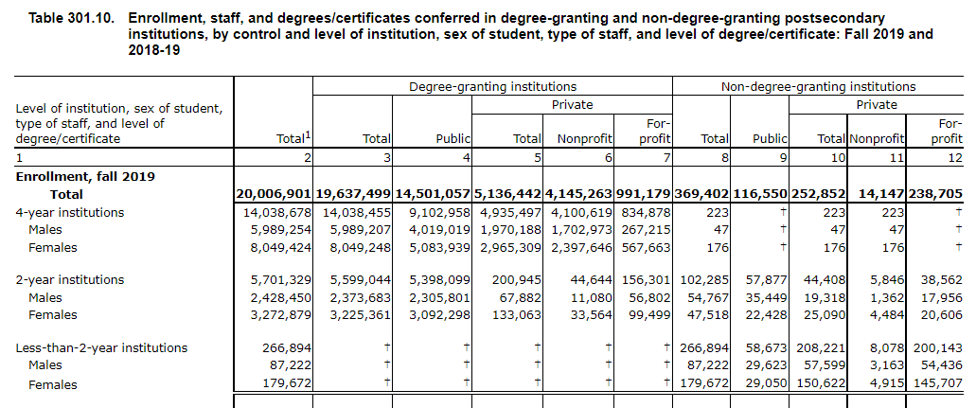
Where do students enroll?
3
Source: NCES Digest of Education Statistics Table 301.10

Slide 4
Things to note
4
About 30 percent of enrollment in 2018-19 was in 2 year institutions
The majority of enrollment is in public institutions (72%)
About 1 million students in for profit education (5%)
Women outnumber men in higher education (57% of 4 year students are female)

Slide 5
Description of Various School Types
5
Public 4 years
  Predominantly not selective
  Biggest sector by far
  Some very selective schools (University of Michigan, UC Berkeley), these are called “flagships”
  Non selective primarily funded by the state. Flagships often raise much more of their money
Public 2 years
  Not selective
  Funded by state/local property taxes

Slide 6
School Types
6
Private Non Profits
  Include the most selective schools (Harvard, Stanford)
  But many schools are less selective than this
  Includes many liberal arts colleges
For Profit Institutions
  Have a profit motive
  Grew in prominence in the last two decades

Slide 7
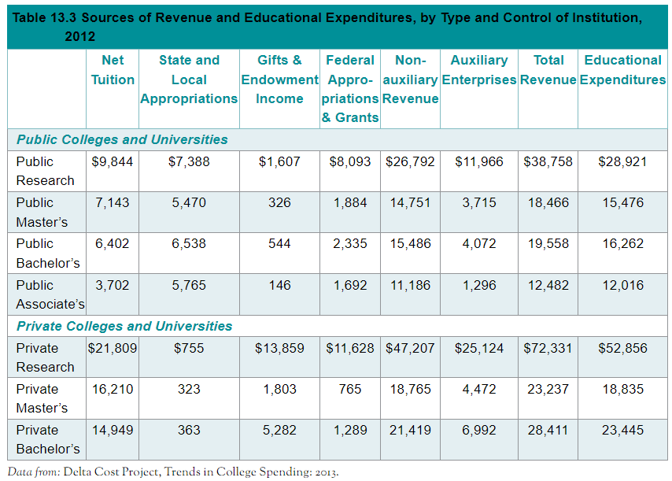
College Resources
7
Source: Lovenheim Turner

Slide 8
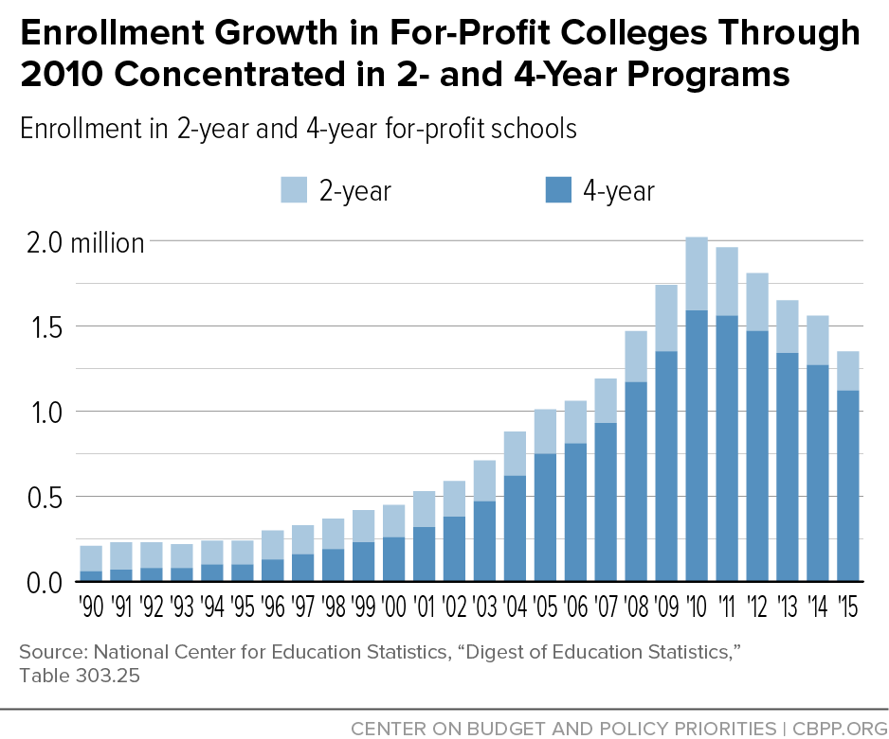
For Profit Enrollment
8
In 2010, For profit enrollment was about 10 percent of all Title IV enrollment
Source: https://www.cbpp.org/enrollment-growth-in-for-profit-colleges-through-2010-concentrated-in-2-and-4-year-programs

Slide 9
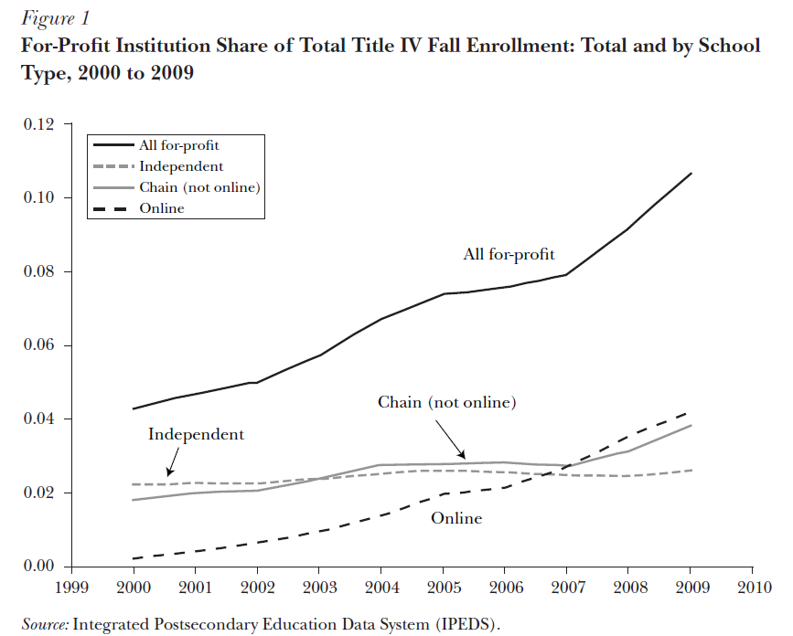
More on for profits
9
Growth in online offerings
But, they’re not all chains, they’re not all online
Source Deming, Goldin, Katz (2012)

Slide 10
Do they offer Returns?
10
Cellini Turner (2019)
Data on all for profit enrollees from Department of Education
Merged to Tax Data
Compare earnings at FP to NFP, also to students who didn’t go to college
Before and after attending college
Worse than public degrees
Zero effect on wages compared to people who didn’t go to college

Slide 11
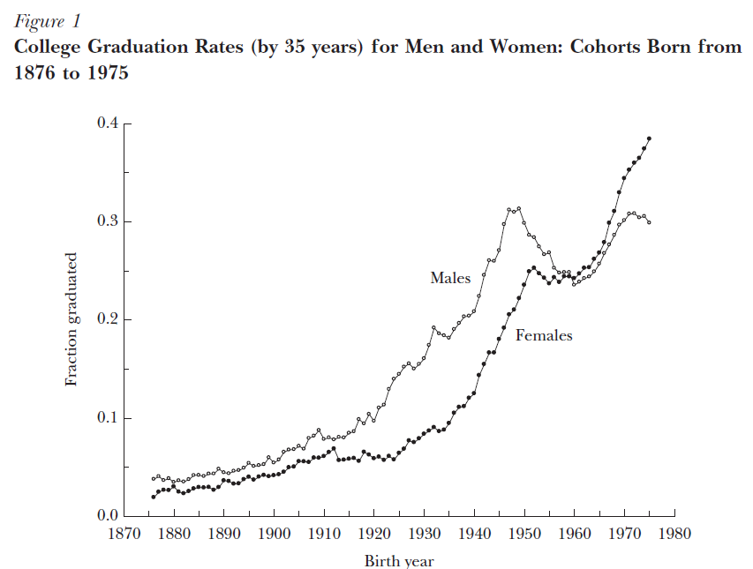
Gender Gap In College Going
11
Source: Goldin Katz Kuziemko (2006)
College enrollment/completion used to be male dominated
It is now female dominated
Similar gap in HS graduation

Slide 12
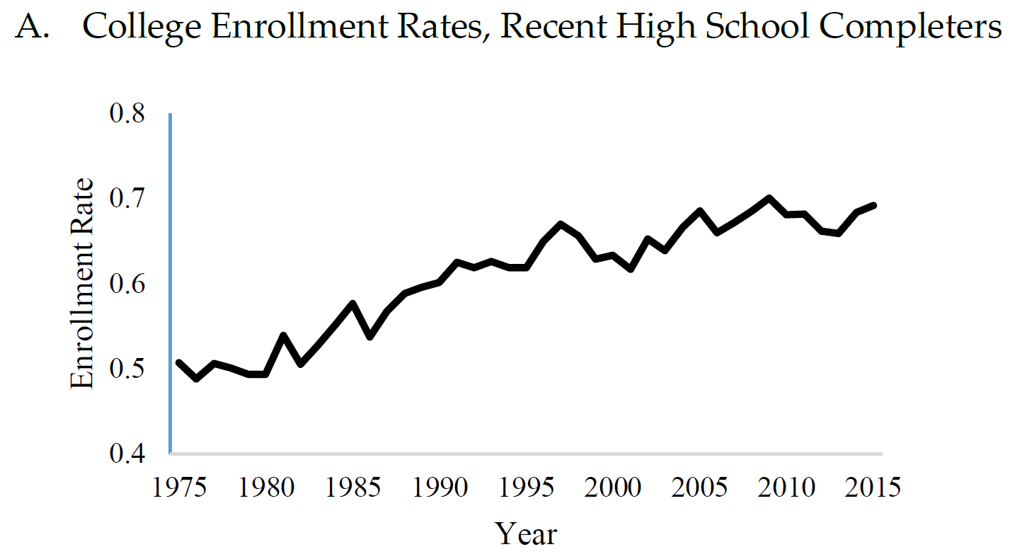
College Enrollment
12
College enrollment is up over time as well
In general, it grows when there is a recession (why?)

Slide 13
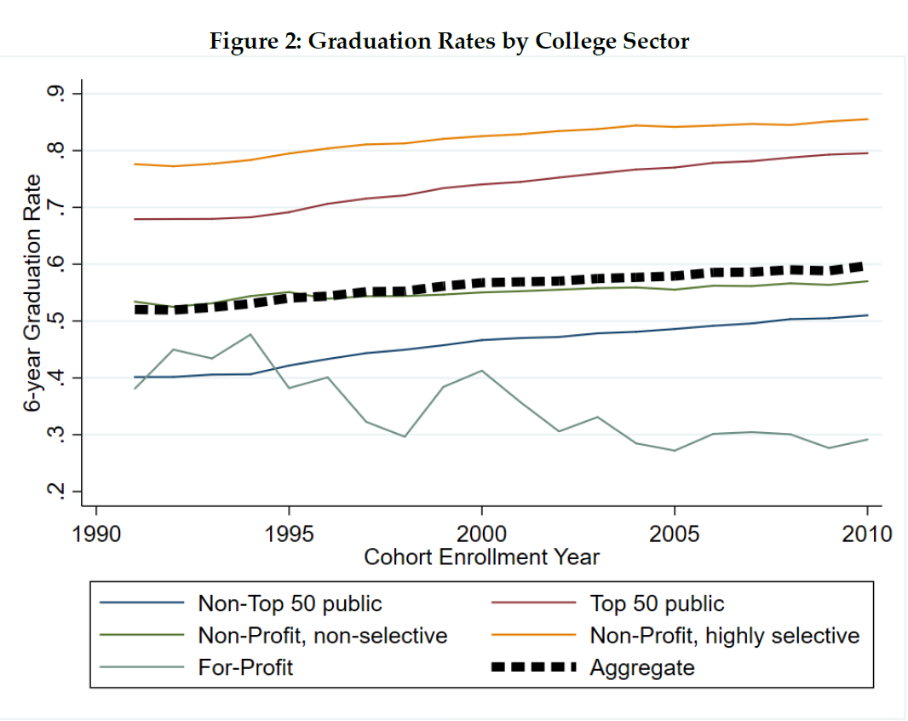
Graduation Rates
13
There is a lot of heterogeneity in college graduation rates by sector
College graduation rates are low!
Even lower for community colleges (36% NCES Digest of Education Statistics)

Slide 14
This is really low!
14
Why might some students stop out?
Financial Reasons
Some other shock in a student’s life (mental health, loss of a loved one, etc)
Fail to meet academic requirements to stay (academic probation, etc)
May discover their schooling ability is lower than anticipated (Aricidacono, Aucejo, Maurel, Ransom 2016)

Slide 15
Big Differences Across School Types in Student Chars
15
It is not random who goes to which college
Selective schools disproportionately have students from high income backgrounds
This complicates estimating the effects of college enrollment

Slide 16
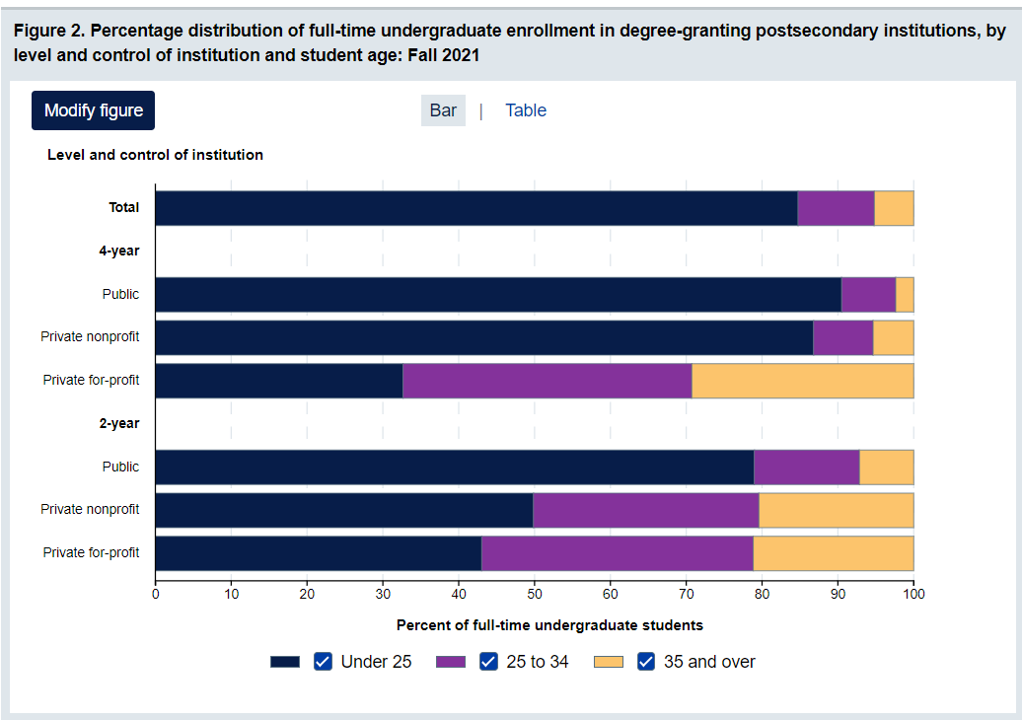
College Student Age
16
https://nces.ed.gov/programs/coe/indicator/csb/postsecondary-students

Slide 17
The Homecoming of American College Women: The Reversal of the College Gender Gap
17
Claudia Goldin, Lawrence F. Katz, Ilyana Kuziemko

Slide 18
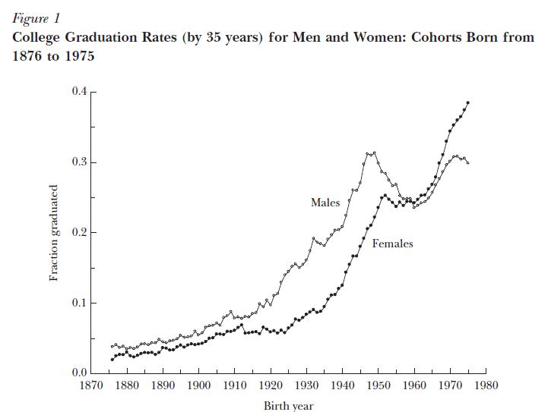
Gender and College
18

Slide 19
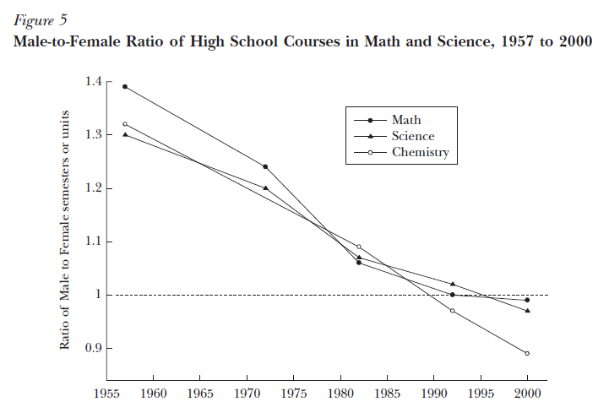
Preparation
19

Slide 20
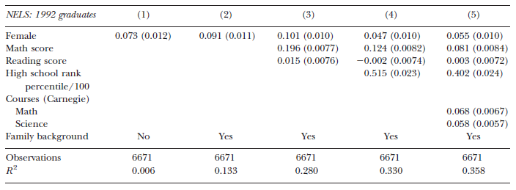
Predictors of graduation
20

Slide 21
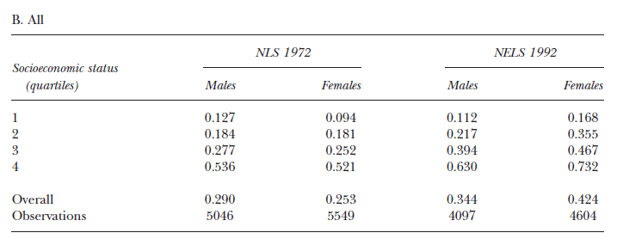
How different is it across the SES distribution?
21
College completion rates

Slide 22
What could be driving this?
22

Slide 23
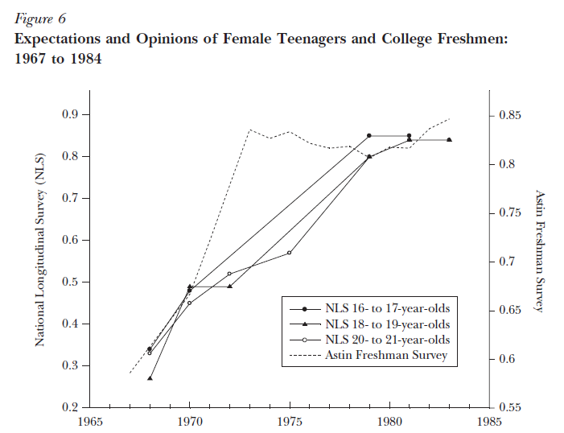
Fraction of Women who expected to be “at work” at age 35
23
Expectations of future work is highly correlated with college completion
What model is this consistent with?

Slide 24
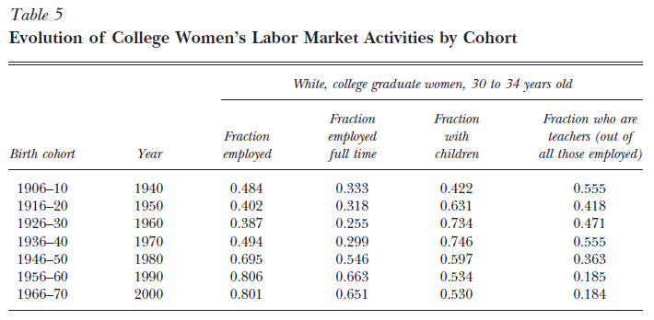
Enormous transformation of labor market for women
24

Slide 25
Why the reversal?
25
Returns to college for women are higher
Women do better in high school
  Behavioral problems thought to be especially important for this change
  Boys do less homework in high school
This appears in high school too

Slide 26
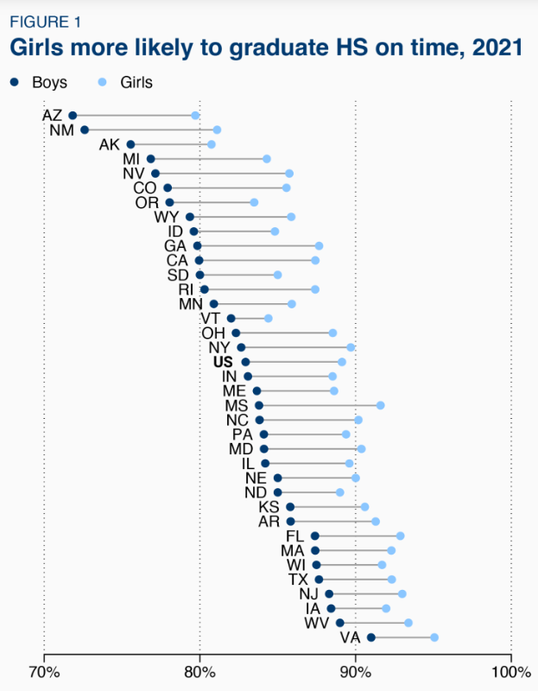
HS Graduation
26
Source: Reeves Kalkat 2023 Brookings

Slide 27
Family Disadvantage and the Gender Gap
in Behavioral and Educational Outcomes
27
David Autor, David Figlio, Krzysztof Karbownik, Jeffrey Roth, and Melanie Wasserman AEJ:A 2019

Slide 28
Setting/Data
28
Florida
People born 1992-2002
Birth certificates linked to school records for public schools

Slide 29
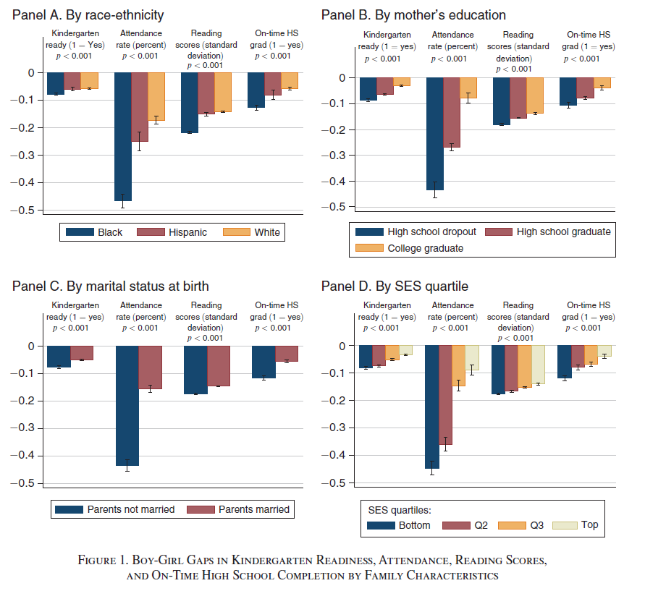
Gender Gaps
29

Slide 30
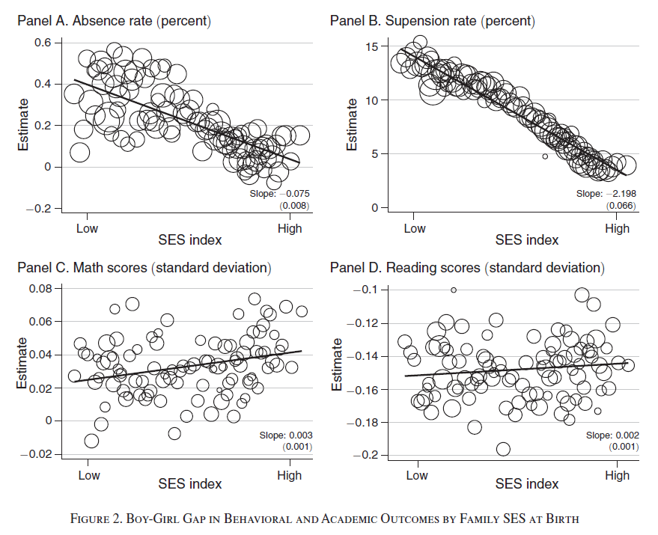
30

